Slide 1
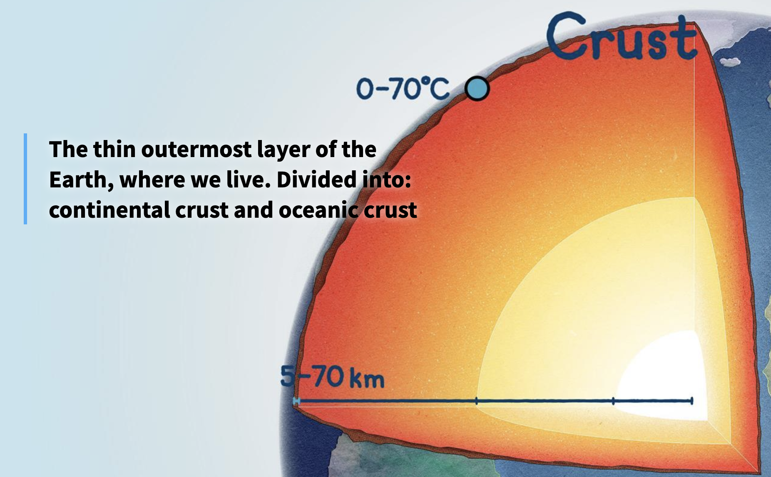
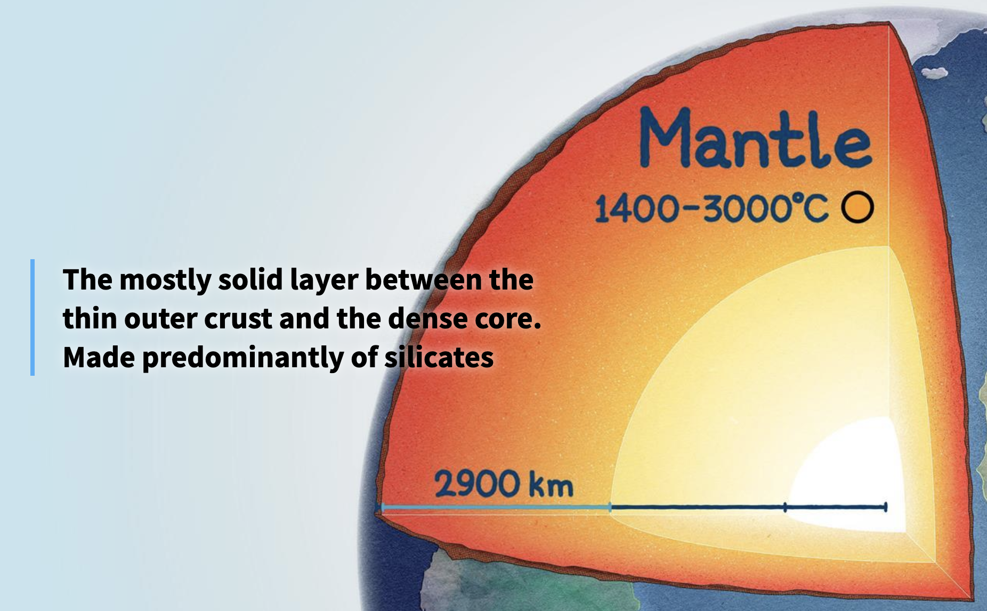
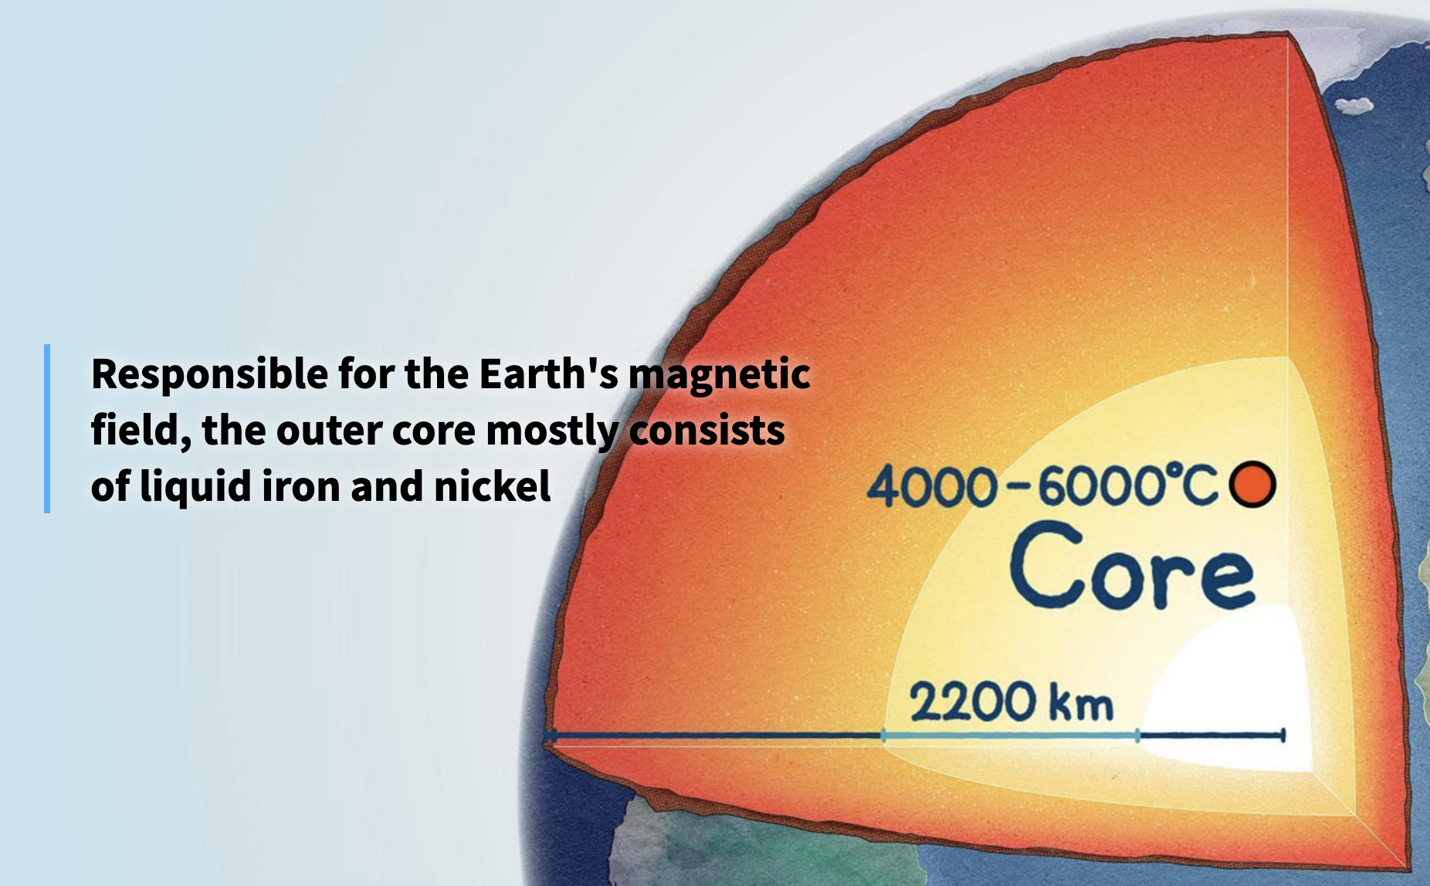
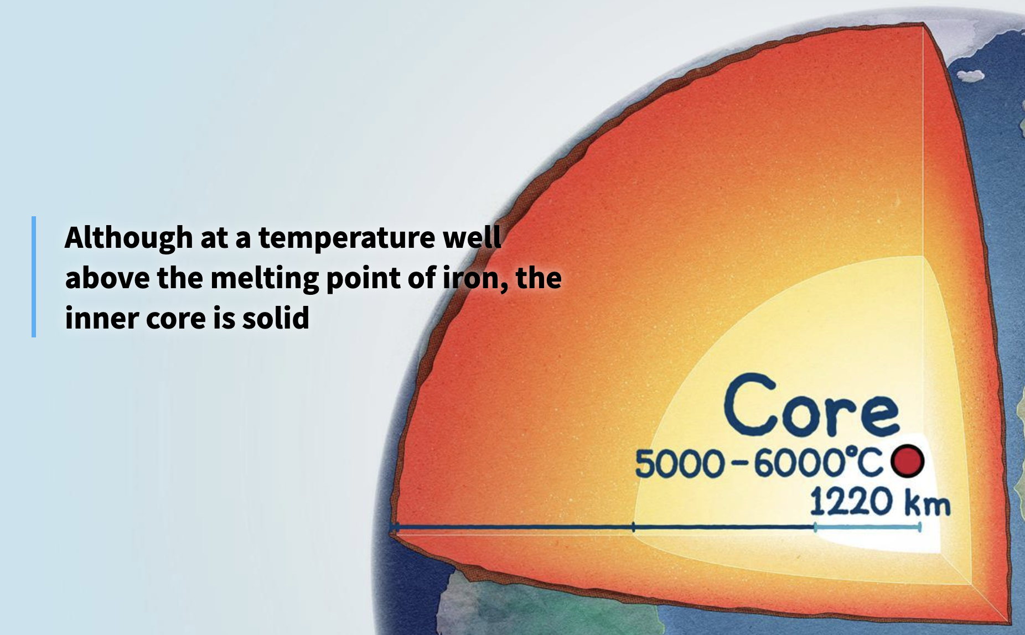
The Layers of the Earth
The Earth is made up of four main layers: the crust, the mantle, the outer core, and the inner core. Each layer is different in thickness, temperature, and material.
The crust is the Earth’s outer layer and the one we live on. It is the thinnest layer and is solid, with an average temperature of about 22°C. There are two types: continental crust, which forms the land, and oceanic crust, which lies beneath the oceans. Oceanic crust is made of elements such as iron, oxygen, silicon, magnesium, and aluminium. Continental crust is mostly granite, sedimentary rocks, and metamorphic rocks.
Oceanic crust is up to 6 km thick, while continental crust can reach 75 km. Beneath the crust lies the asthenosphere, a softer, semi-molten layer in the upper mantle. The crust rests on this layer, which allows the tectonic plates to slowly move.
Beneath this lies the mantle, which is about 2,900 km thick. The mantle is solid but contains semi-molten rock called magma. Its temperature ranges from 1,000°C to 3,500°C. The mantle makes up around 80% of Earth’s total weight and is mostly made from iron, oxygen, silicon, magnesium, and aluminium.
The next layer is the outer core. This is unusual because it is completely liquid. It is about 2,220 km thick and contains iron, nickel, sulphur, and oxygen. Its temperature ranges between 4,000°C and 6,000°C. The movement of liquid metal in the outer core produces the Earth’s magnetic field.
Finally, at the centre, is the inner core. This is smaller, about 1,260 km thick, but it is the hottest part of the Earth, with temperatures from 5,000°C to 6,000°C. It is made only from iron and nickel. Even though it is so hot, the inner core remains solid because of the extreme pressure around it.

Slide 2

The Layers of the Earth
The Earth is made up of four main layers: the crust, the mantle, the outer core, and the inner core. Each layer is different in thickness, temperature, and material.
The crust is the outer layer of the Earth and the part we live on. It is the thinnest layer and is solid, with an average temperature of around 22°C. There are two types: continental crust, which makes up the land, and oceanic crust, which lies under the seas. Oceanic crust is made from elements such as iron, oxygen, silicon, magnesium, and aluminium.
Continental crust is mostly granite, as well as sedimentary and metamorphic rocks. Oceanic crust can be up to 6 km thick, while continental crust can reach 75 km. Under the crust is the asthenosphere, a softer layer of the mantle. The crust sits on this layer, which lets the plates slowly move.
Under the crust is the mantle, which is about 2,900 km thick. It is solid but also has some semi-molten rock called magma. Its temperature is between 1,000°C and 3,500°C. The mantle makes up about 80% of Earth’s weight and is mostly made of iron, oxygen, silicon, magnesium, and aluminium.
The next layer is the outer core, which is different because it is fully liquid. It is about 2,220 km thick and is made of iron, nickel, sulphur, and oxygen. Its temperature is between 4,000°C and 6,000°C. The movement of the liquid metal here creates the Earth’s magnetic field.
Finally, at the centre is the inner core. It is smaller, about 1,260 km thick, but it is the hottest part of the Earth, with temperatures between 5,000°C and 6,000°C. It is made only of iron and nickel. Even though it is so hot, the inner core stays solid because of the huge pressure around it.

